Slide 1

Predicting Customer buying behavior

Slide 2
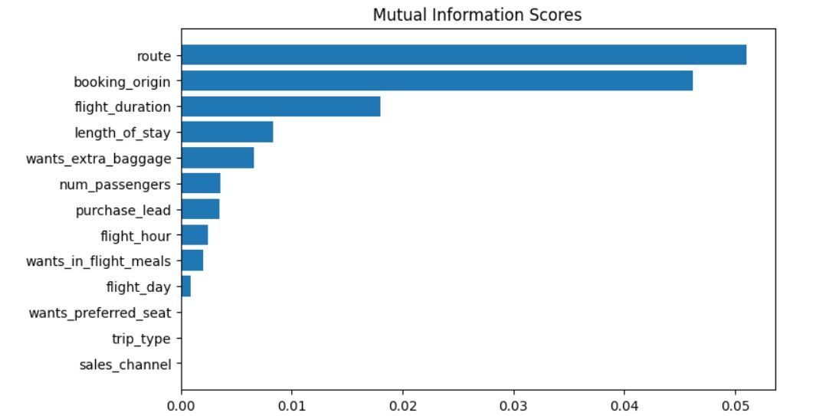
Predictive model to understand factors that influence buying behavior:
The dataset underwent training using a Random Forest Classifier model, yielding the following outcomes:
The five key features that exert influence on customer purchasing behavior:
Route
Booking_origin
Flight_duration
Length_of_stay
Wants_extra_baggage
ACCURACY: 85.09 AUC score: 0.558

